Slide 1
Information System Management and Strategy
Unit - 3

Slide 2
Organization and Information System
Information systems and organizations influence each other.
Information systems are designed by managers to align with business goals.
Organizations must adapt to and embrace new technologies.
Mutual interaction drives innovation and operational efficiency.

Slide 3
Organization and Information System
Interaction between IT and organizations is complex.
Influencing factors include:
  Organizational structure
  Business processes
  Politics
  Culture
  Surrounding environment
  Management decisions
Designing information systems requires a deep understanding of organizations.

Slide 4
Organization and Information System
In microeconomic definition of organizations, Capital and labor are primary production factors.
Firms transform inputs into outputs (products and services).
Outputs are consumed by the environment.
Environment provides additional inputs through a feedback loop.

Slide 5
Organization and Information System
In Technical View of Organizations:
Formal, legal, social structure that processes inputs into outputs.
Capital and labor are interchangeable and flexible.
In Behavioral View of Organizations:
Collection of rights, privileges, obligations, and responsibilities.
Balanced over time through conflict and resolution.
Building/rebuilding systems requires
  more than technical changes.
  Changes in ownership, control, and access to information.
  New decision-making processes about "who, when, and how."

Slide 6
Impact of Information Systems
Affects:
Organizational structure, goals, and work design.
Values, competition, decision-making, and day-to-day behavior.
Must align with:
Structure, business processes, goals, culture, politics, and management.

Slide 7
Impact of Information Systems
Advantages of IT Integration:
Reduces transaction and agency costs.
Benefits amplified by internet technologies.
Challenges of New Systems:
Disrupts established work patterns and power dynamics.
Often faces resistance during implementation.

Slide 8
Roles of information system in an organization
Automation of Manual Tasks:
Automates tasks using robotic and logical systems.
Examples:
  Robotic systems in health and medical services.
  Automated warehouses and distribution systems.
Hardware and Software Integration:
Merges multiple computer platforms seamlessly.
Scalable platforms unify hardware and software systems.
Decision Support:
Provides critical data for executive decision-making.
Supports strategic planning and operational efficiency.

Slide 9
Roles of information system in an organization
Support for Multi-Processing Environment:
Enables "real-time" multi-processing through time-sharing applications.
Prioritizes tasks based on:
  User ID.
  Application, device, and database/system catalog priorities.
System Partitioning:
Organizes system layout based on:
  Data security policies.
  User access levels.
  Program applications.
Ensures effective CPU usage through partitioning of drives, memory, and storage.

Slide 10
Impact of Information System in an Organization and Business Firm
Integral Role in Operations:
Essential online and interactive tools.
Involved in real-time operations and decision-making.
Transformative Effect:
Fundamentally changed organizational economics over the last decade.
Enhanced possibilities for organizing work efficiently.
Interdisciplinary Understanding:
Economic theories explain shifts in organizational costs and efficiencies.
Sociological concepts shed light on changes in work dynamics and collaboration.

Slide 11
Economic Impacts of Information Systems
Change in Costs:
IT reduces both the relative cost of capital and cost of information.
Substitutes traditional capital (machinery, buildings) and labor (especially middle managers and clerical workers).
Substitution of Labor:
As IT costs decrease, it replaces labor, particularly roles with rising costs.
Decrease in the need for middle managers and clerical workers due to IT automation.

Slide 12
Economic Impacts of Information Systems
Increased Investment in IT:
IT becomes more attractive as its costs decline compared to other capital investments (e.g., buildings, machinery).
Over time, managers will invest more in IT due to its lower relative costs.
Transaction Cost Theory:
Firms aim to economize on transaction costs, such as:
  Locating and communicating with suppliers.
  Monitoring contracts, purchasing, and obtaining product information.
Networks and IT lower market participation costs, making outsourcing more cost-effective than hiring internally.

Slide 13
Economic Impacts of Information Systems
Impact on Firm Size:
As transaction costs decrease, firms shrink in size due to outsourcing becoming cheaper than internal production.
Firm size can contract or stay constant while revenues increase, as outsourcing is more cost-efficient.
Agency Theory:
Firms are seen as a "nexus of contracts" among self-interested individuals.
Agency costs (coordination and supervision) rise as firms grow, requiring more management effort.
  IT reduces agency costs by making it easier to acquire and analyze information, thus simplifying supervision.

Slide 14
Economic Impacts of Information Systems
Management Cost Reduction:
IT enables reduction in internal management costs by allowing better oversight of a larger workforce.
As a result, firms can reduce the number of middle managers and clerical workers, while increasing revenue.
Overall Impact on Firm Size and Efficiency:
As IT reduces agency and transaction costs, firms tend to shrink in size over time.
Revenue per employee increases due to reduced management costs and greater efficiency.

Slide 15
Organizational and Behavioral Impact of Information Technology
IT Flattens Organizations
Postindustrial Organizations
Understanding Organizational Resistance to Change

Slide 16
IT Flattens Organizations
Old Organizations vs. New Organizations:
Pre-computer organizations were often inefficient, slow to adapt, and less competitive.
IT helps flatten hierarchies by distributing information, empowering lower-level employees, and improving decision-making efficiency.

Slide 17
IT Flattens Organizations
Impact on Decision Making:
IT enables lower-level employees to make decisions without constant supervision by providing necessary information.
Managers receive more accurate, timely data, leading to faster decisions and fewer managers needed.
As management costs decline, the organizational hierarchy becomes more efficient.
Empowerment of Middle Management:
IT may empower middle managers by providing more information, enabling them to make significant decisions, which can reduce the need for large numbers of lower-level workers.

Slide 18
Postindustrial Organizations
Historical and Sociological Theories:
In postindustrial societies, authority shifts from formal positions to knowledge and competence.
Organizations flatten as professionals become self-managing, and decision-making becomes decentralized with more widespread access to knowledge.
Task Forces and Networked Organizations:
IT encourages task-forced, networked organizations where professionals collaborate temporarily on specific tasks, after which they join other teams.
Example: Accenture operates without a formal headquarters, with employees rotating across locations to work on various projects globally.

Slide 19
Postindustrial Organizations
Virtual Organizations:
Virtual organizations use networks to connect people, assets, ideas, suppliers, customers, and sometimes competitors.
Implementing virtual work requires new approaches to evaluate, organize, and inform workers.
Challenges in virtual organizations:
  Who ensures self-managed teams stay on track?
  Who decides team assignments and durations?
  How to evaluate performance of employees rotating across teams?
  How to guide employee career development?

Slide 20
Understanding Organizational Resistance to Change
Impact on Organizational Politics:
Information systems influence access to key resources—information—affecting organizational roles, decision-making, and processes.
Challenges of Change:
New information systems require changes to personal routines, leading to discomfort, retraining, and additional effort.
IT adoption can disrupt organizational structure, culture, business processes, and strategy, leading to resistance.

Slide 21
Understanding Organizational Resistance to Change
Visualization of Organizational Resistance:
Leavitt’s diamond model illustrates the interrelated nature of technology, task structure, and people in organizational change.
Changes to technology, tasks, and people must occur simultaneously to overcome resistance.
Failure of IT Projects:
Organizational and political resistance is often the primary reason for the failure of large IT projects, rather than technological issues.
Resistance to change can hinder productivity improvements despite technological investments.

Slide 22
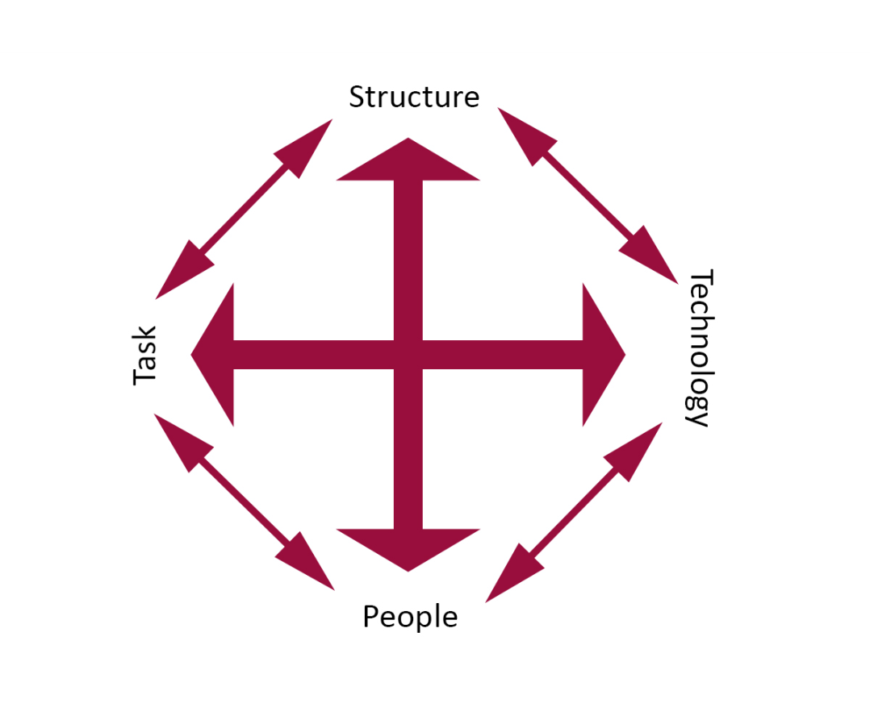
Leavitt’s diamond model

Slide 23
The Internet and Organization
Impact on External Relationships:
The Internet, particularly the World Wide Web (WWW), has a significant impact on the relationships between firms and their external entities (e.g., suppliers, customers, partners).
The Internet enhances the accessibility, storage, and distribution of information and knowledge, improving business interactions.
By reducing barriers to communication, firms can establish more efficient and timely connections with external stakeholders.

Slide 24
The Internet and Organization
Lowering Transaction and Agency Costs:
The Internet plays a key role in reducing transaction and agency costs for organizations.
Example: Brokerage firms and banks in Itahari and Pokhara can now distribute internal operating procedure manuals to employees in distant locations through corporate websites, saving millions in distribution costs.

Slide 25
The Internet and Organization
Rebuilding Business Processes:
Organizations are increasingly rebuilding key business processes around Internet technologies and integrating them into their IT infrastructure.
As a result, businesses are simplifying their processes, requiring fewer employees, and adopting flatter organizational structures compared to traditional models.
The Internet facilitates more streamlined operations, reducing the need for complex hierarchies and centralized control.

Slide 26
Using Information System to achieve competitive advantage
Competitive advantage enables firms to outperform rivals.
Achieved through : Access to unique resources.
Efficient use of common resources.
Result: Higher revenue, profitability, productivity, and stock market valuations.

Slide 27
Industry Leaders Powered by Information Systems
Automotive: Toyota - superior performance.
Online Retail: Amazon - industry leader.
Offline Retail: Walmart - largest global retailer.
Digital Music: Apple iTunes, YesAsia, CDJapan - 75% market share.
Web Search: Google - market leader.
Smartphones: Android OS - most popular.

Slide 28
Key Success Factors for Competitive Advantage
Superior knowledge and expertise.
Efficient resource management.
Access to critical information assets.
Continuous investment in IT and innovation.

Slide 29
Michael Porter's Competitive Forces Model
Using information system to achieve competitive advantages can be described by Michael Porter’s Competitive Forces Model
Key Forces:
Industry competition.
Bargaining power of suppliers.
Bargaining power of customers.
Threat of new entrants.
Threat of substitutes.
Note: Information systems help address these forces strategically.

Slide 30
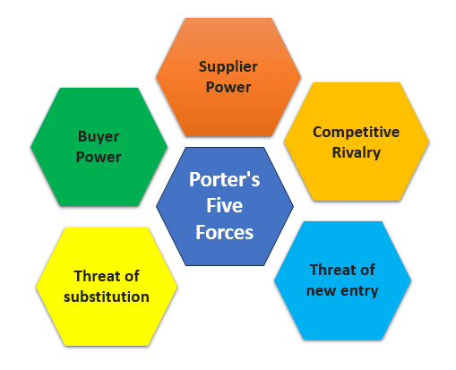
Fig: Porter’s Five Forces

Slide 31
Overview of Porter’s Competitive Forces Model
Widely used framework for analyzing competitive advantages.
Provides a holistic view of:
The firm.
Competitors.
External business environment.
Five key forces shaping the firm's strategy and success.

Slide 32
Traditional Competitors/ Industry competition
Compete for the same market space.
Strategies include:
New products/services.
Improved efficiency.
Brand development.
Imposing switching costs on customers.

Slide 33
Threat of new entrants
Continuous entry of new firms in free markets.
Advantages:
No legacy systems or outdated processes.
Cost-effective workforce.
Higher innovation potential.
Challenges:
High capital requirements in some industries.
Dependence on external financing.
Limited brand recognition and experience.

Slide 34
Substitute Products and Services/ Threat of substitutes
Substitute options reduce pricing control and profit margins.
Examples:
Ethanol replacing gasoline.
Internet services replacing traditional telephony.
Digital downloads replacing CDs.
Constant innovation creates new substitutes.

Slide 35
Barganing power of Customers
Key to business success: Attracting and retaining customers.
Factors influencing customer power:
Easy switching to competitors.
Transparent marketplaces with price competition.
Product differentiation and brand loyalty.
Example: Online textbook markets empower customers.

Slide 36
Barganing power of Suppliers
Good supplier relations are critical for business success.
Supplier power impacts profitability:
  Higher supplier power reduces margins.
  Control increases with diverse supplier options.
Example: Laptop manufacturers leveraging multiple component suppliers.

Slide 37
Implications of Porter’s Model
Helps firms analyze their position in the industry.
Guides strategies to:
  Enhance competitive advantage.
  Manage external forces effectively.
Emphasis on innovation, efficiency, and relationship management.

Slide 38
Information System Strategies for Dealing with Competitive Forces
Overview of Strategies
Firms can counter competitive forces using information systems.
Four generic strategies:
Low-cost leadership.
Product differentiation.
Focus on market niche.
Strengthening customer and supplier intimacy

Slide 39
Low-Cost Leadership
Reduce operational costs and offer lowest prices.
Strategies: Automating inventory management and replenishment.
Example: Big Bazaar: Continuous replenishment systems for real-time restocking.
Reduced inventory holding costs and improved responsiveness to demand.

Slide 40
Product Differentiation
Enable unique products or enhance customer experience.
Strategies:
Introduce innovative services (e.g., Google Maps).
Support mass customization (e.g., NIKEid: Personalized sneakers).
Use IT to integrate customer preferences into production.
Benefits: Stand out in the market, cater to individual customer needs.

Slide 41
Focus on Market Niche
Target and serve narrow markets better than competitors.
Strategies:
Analyze customer data to tailor marketing efforts.
Use advanced tools to identify buying patterns and preferences.
Example: Hilton Hotels OnQ System: Personalized services for profitable guests.
Benefits: Enhanced customer loyalty, higher market efficiency.

Slide 42
Strengthening Customer and Supplier Intimacy
Build strong relationships with suppliers and customers.
Strategies:
Direct supplier access to production schedules (e.g., Tata Motors).
Personalized customer recommendations (e.g., Amazon).
Benefits:
Increased switching costs for customers.
Improved supplier reliability and lead time.

Slide 43
Business Value Chain Model
Introduction to the Business Value Chain Model
Purpose: Highlights specific activities where competitive strategies can be applied effectively.
Goal: Create value by tailoring products/services to meet customer needs.
Porter’s Value Chain:
  Introduced in 1985.
  Analyzes activities for sources of sustainable competitive advantage.

Slide 44
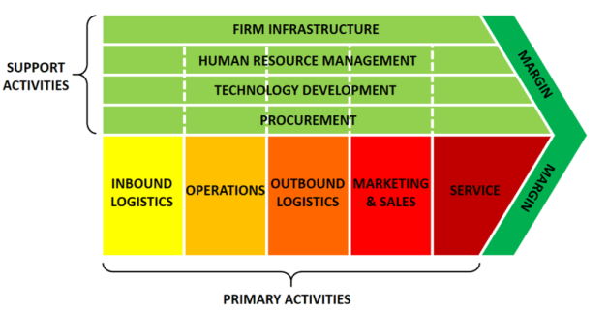
Fig: A Value Chain Model

Slide 45
Key Components of the Value Chain
Primary Activities: Directly related to production and delivery of products/services.
Support Activities: Enable primary activities and improve efficiency.
Outcome: Adds value exceeding the cost of activities to achieve a marginal value gain.

Slide 46
Primary Activities in the Value Chain
Inbound Logistics: Receiving, storing, and managing raw materials.
Example: Efficient inventory systems.
Operations: Converting inputs into finished goods/services.
Example: Streamlined manufacturing processes.
Outbound Logistics: Warehousing and distributing finished products.
Example: Advanced distribution networks.

Slide 47
Primary Activities in the Value Chain
Sales and Marketing: Promoting and selling products.
Example: Targeted advertising campaigns.
Service: Post-sale support, maintenance, and repair.
Example: Comprehensive warranty services.

Slide 48
Support Activities in the Value Chain
Firm Infrastructure: Includes general management, finance, and planning.
Example: Effective leadership and resource allocation.
Human Resource Management: Hiring, training, and retaining skilled employees.
Example: Employee development programs.

Slide 49
Support Activities in the Value Chain
Technology Development: Research and innovation for better products/processes.
Example: Investment in cutting-edge tech.
Procurement: Sourcing quality inputs at competitive prices.
Example: Building strong supplier relationships.

Slide 50
Value Addition through Information Systems
Key Leverage Points for IT:
  Automating logistics for faster delivery.
  Data analytics for targeted marketing.
  CRM systems for enhanced customer service.
  ERP systems for seamless operations.
Strategic Impact: Enhances efficiency, reduces costs, and delivers superior value.

Slide 51
Value Addition through Information Systems
Example: Integration of IT in the Value Chain
Amazon’s Value Chain:
  Inbound Logistics: Automated inventory systems.
  Operations: AI-driven warehouse management.
  Outbound Logistics: Optimized delivery routes.
  Sales and Marketing: Personalized recommendations using AI.
  Service: 24/7 customer support and returns management.

Slide 52
Benefits of the Value Chain Model
Identifies critical activities for gaining competitive advantage.
Highlights areas where IT can enhance performance.
Helps in aligning activities with strategic goals.
Improves customer satisfaction and overall profitability.

